Slide 1
Questions regarding WPG
Temporal simulation
Nan Wang, May 20th 2020

Slide 2
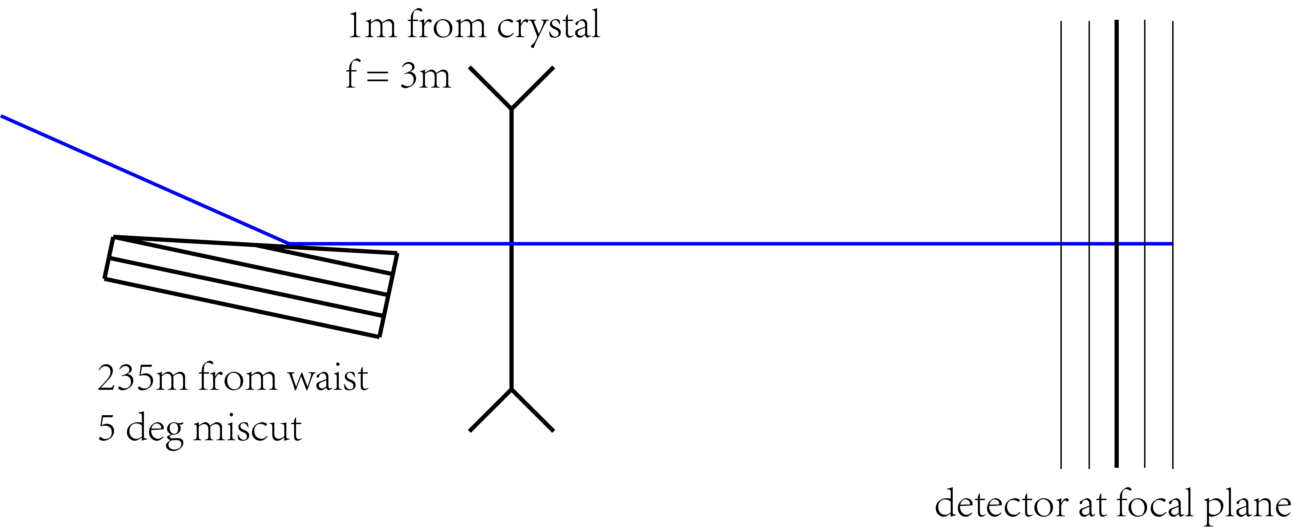
Schematics
Drift
Drift to multiple slices
Crystal:
initialized through SRWLOptCryst() using Si 111 with 5 deg miscut, orientation calculated using find_orient().
Lens:
constructed as 2D thickness profile (PMMA) assuming perfect lens,
then converted to OPD and amplitude transmission.

Slide 3
Sampling parameters
Incident beam:
wfr0 = build_gauss_wavefront(
npoints, npoints, nz, ekev, -range_xy/2, range_xy/2,
-range_xy/2, range_xy/2 ,pulse_duration, sigX, sigX, z1,
pulseEn=pulseEnergy,pulseRange=pulseRange)
npoints = 2000; nz = 60; ekev = 6.742; range_xy ~ 2e-3;
pulse_duration = 1, 5, 10e-15; sigX ~ 11.5e-6; z1 = 235;
pulseEnergy = 0.5e-3, pulseRange = 30

Slide 4
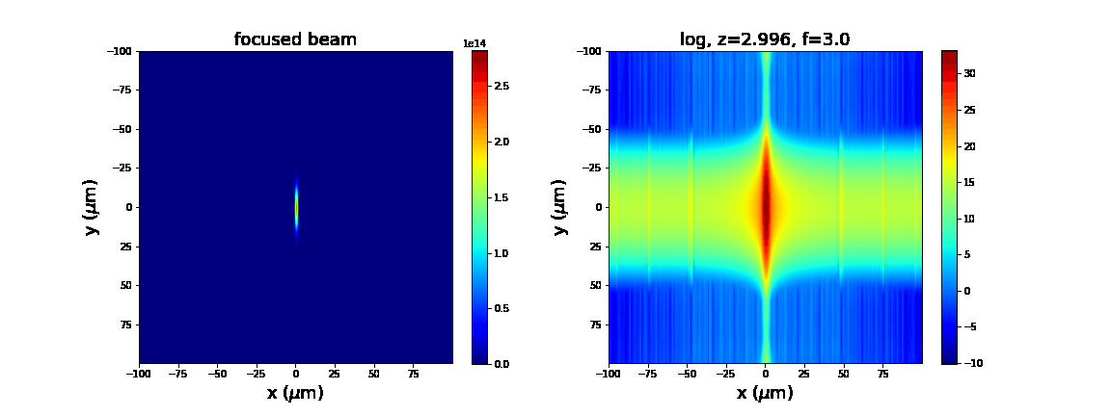
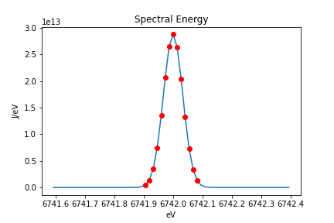
Results 10fs
Beam intensity (and log scale) plotted at 2mm slices around focal plane.
Spectrum after asymmetric reflection.

Slide 5
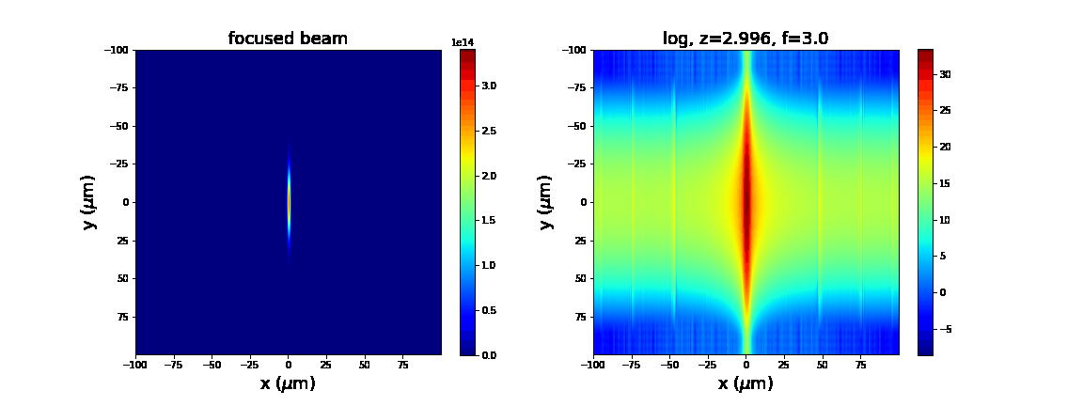
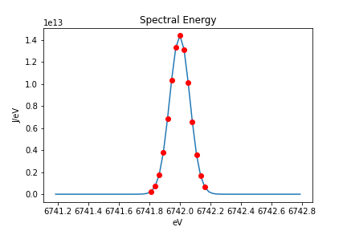
Results 5fs
Beam intensity (and log scale) plotted at 2mm slices around focal plane.
Spectrum after asymmetric reflection.

Slide 6
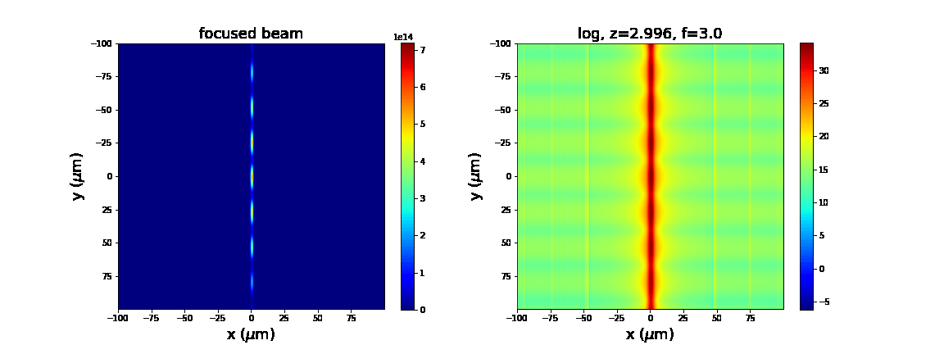
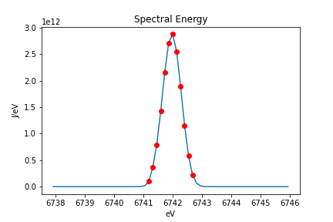
Results 1fs
Beam intensity (and log scale) plotted at 2mm slices around focal plane.
Spectrum after asymmetric reflection.

Slide 7
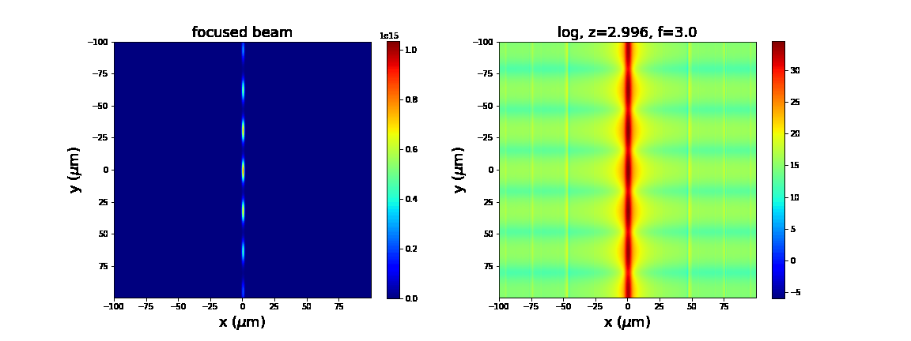
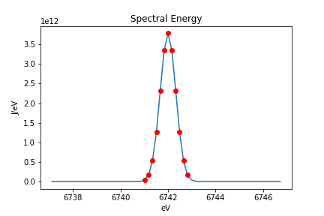
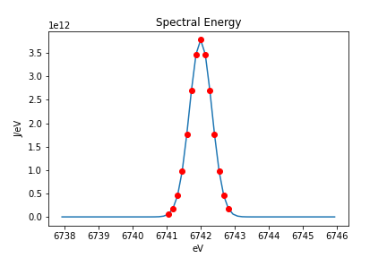
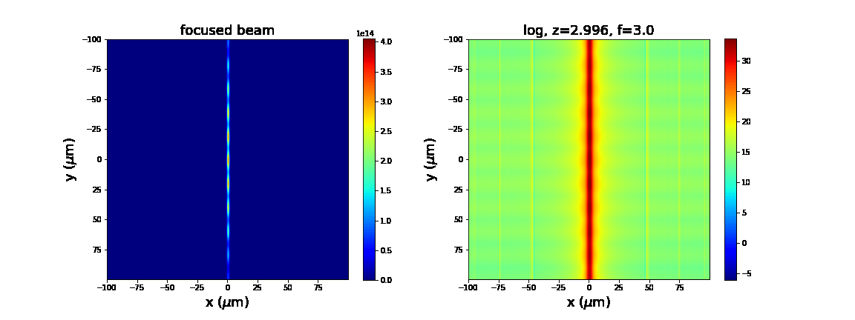
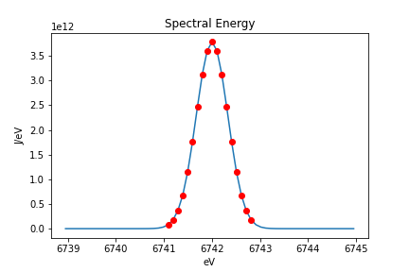
Increasing pulseRange
25
30
40

Slide 8
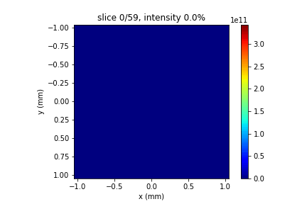
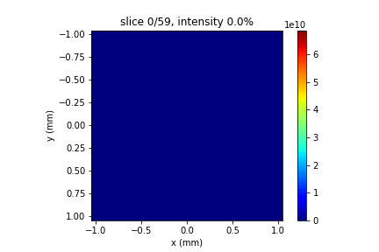

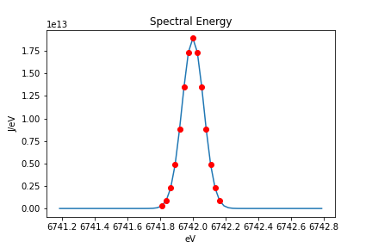
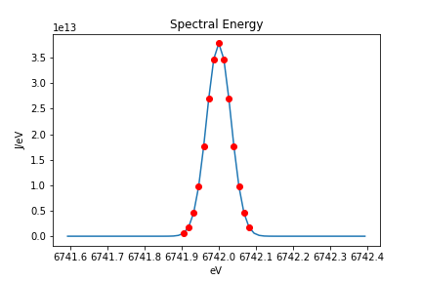
Incident beam time separation
L: 1fs, M: 5fs, R: 10fs
Question:
fixing nz and pulseRange seemingly produce the exact same nz slices regardless of pulse duration. What is the time separation between nz slices?

